Slide 1
KESA Informational Session
August – September 2024

Slide 2
Welcome and Introductions

Slide 3

Introductions
Your name and role.
Why did you decide to attend today?

Slide 4

Table Top Discussion
What is your perception of KESA 2.0?
What questions, if any, have you brought to this discussion?

Slide 5
Today’s topics
1. Overview of KESA 2.0
2. School Improvement Days

Slide 6
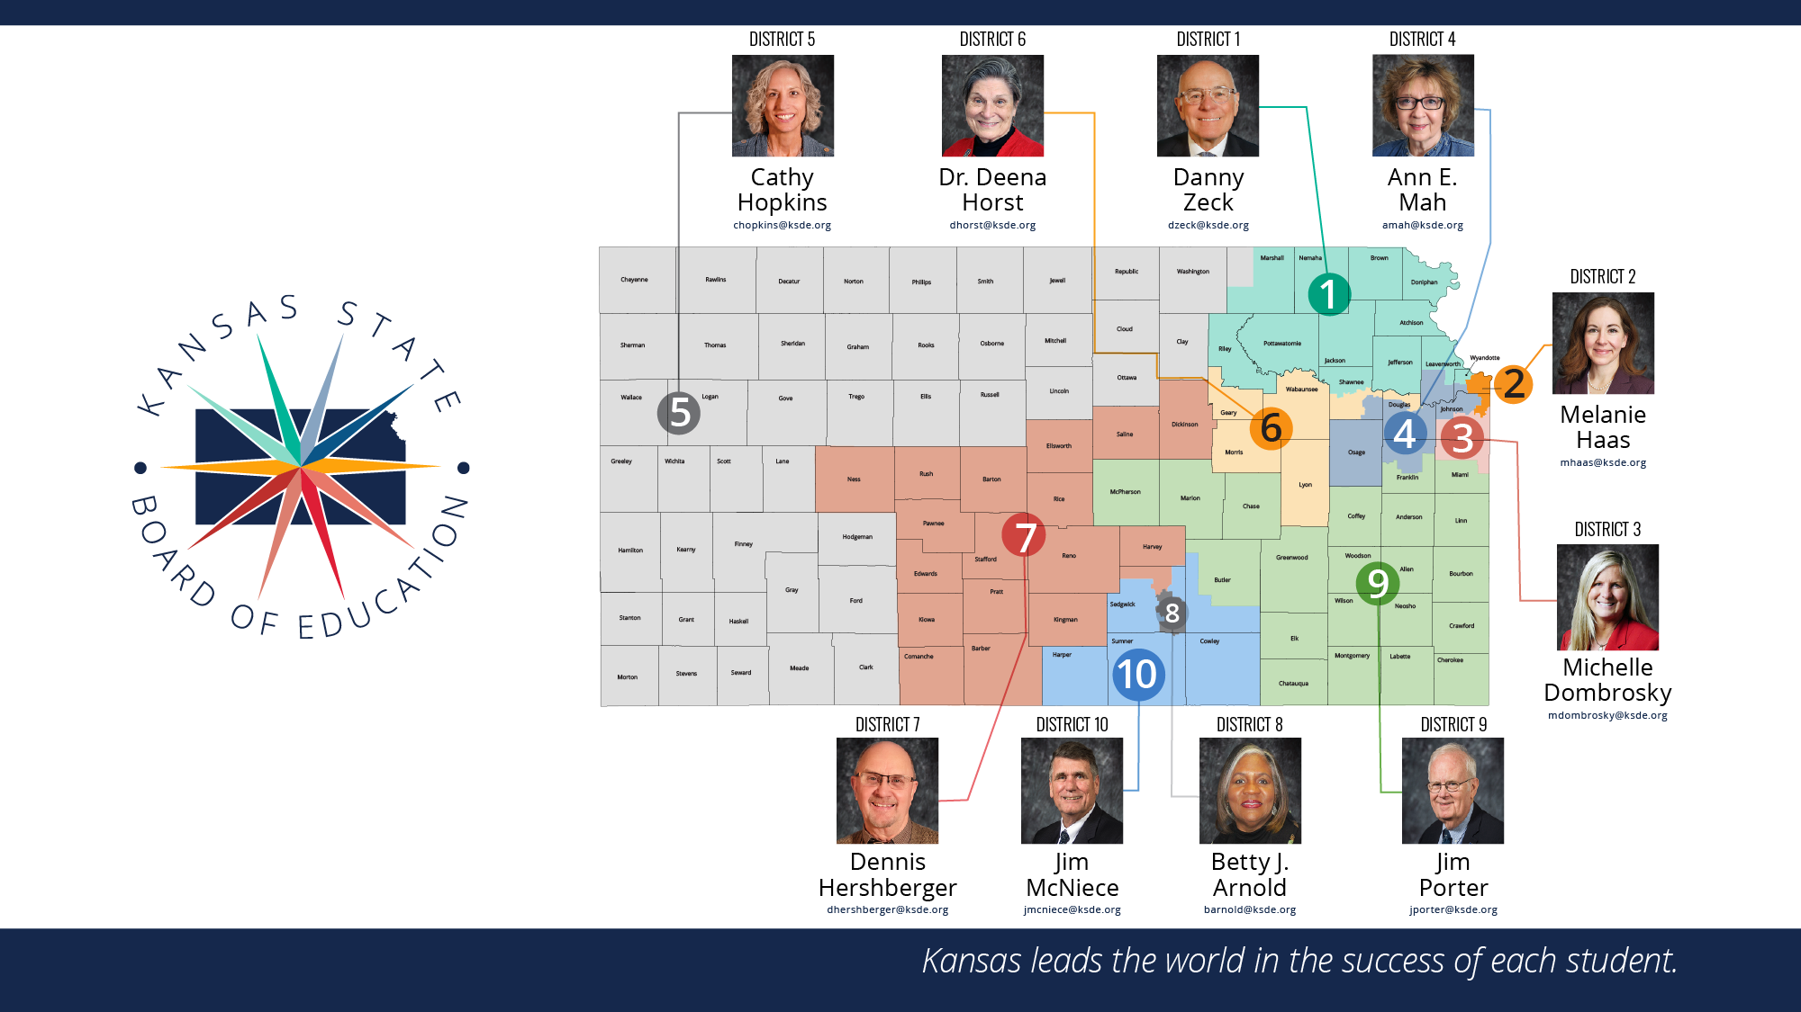

Slide 7

Our Vision for Kansas ...
Kansas leads the world in the success of each student

Slide 8

Our Mission for Kansas…
To prepare Kansas students for lifelong success through rigorous, quality academic instruction, career training, and character development according to each student's gifts and talents.

Slide 9


A Successful Kansas High School Graduate has the
Academic preparation,
Cognitive preparation,
Technical skills,
Employability skills and
Civic engagement
to be successful in postsecondary education, in the attainment of an industry recognized certification or in the workforce, without the need for remediation.

Slide 10
Overview of KESA 2.0

Slide 11
KESA 2.0 – Main messages
Instructionally-focused
Improved environment for teachers.
Flawed
Sustainable improvement

Slide 12

If we strengthen coherence across Kansas through focusing on a few high-leverage, fundamental actions, then our students will develop more knowledge and skills leading to greater opportunities and fewer limitations.
Notes:
Fullan
Add Kansans Can Logo

Slide 13
Accreditation Determination Areas
Compliance
School Improvement
Outcomes
Each accreditation area has:
A set standard to meet.
A measure to evaluate a school system’s performance.
Supports to assist systems in meeting the standard.

Slide 14
KESA Compliance
The standard to reach in each compliance area can be found by going to this 2024-2025 KESA Compliance Guide.
Compliance standards remain the same for 24-25.
KSDE Compliance workgroup is evaluating each compliance area this year to ensure the standards are relevant to the work of school improvement.
Systems can expect changes to Compliance for 2025-2026

Slide 15

School Improvement: Standard
The school system
  Engages in the KESA 2.0 Collaboration Process,
  Builds a quality action plan, and
  Implements the action plan effectively.

Slide 16
KESA Outcomes
ELA & Math State Assessments, HS Graduation, Postsecondary Effectiveness
Standards will involve:
  Targets – State Goal, Threshold
  Improvement toward targets
KESA Outcome Standards are currently being drafted. An initial draft will be presented to the State BOE in October 2024 and presented to the State BOE in final form in December 2024.
Outcomes will be evaluated for accreditation beginning in 26-27

Slide 17
School Improvement: Supports
There are supports throughout this process based on the needs of the school system.

Slide 18
KESA Roles and Responsibilities
Systems
Engage in the KESA Collaboration Process, including development and implementation of an action plan.
KSDE
Analyzes information and presents to the Accreditation Review Council (ARC) when a system is not meeting a standard.
ARC
Reviews compliance issues, information and data from KSDE. Makes recommendation to the State Board.
KSBE
Determines accreditation.

Slide 19
Timeline
Implementation | School Year | Compliance | School Improvement | Outcomes
Year 1 | 2024-2025 | Report Evaluate | Evaluate Action Plan | Report
Year 2 | 2025-2026 | Report Evaluate | Evaluate Action Plan Implementation | Report
Year 3 | 2026-2027 | Report Evaluate | Evaluate Action Plan Implementation | Report Evaluate*
*We will begin evaluating outcomes in 2026-27 school year.

Slide 20
Accreditation Determination Examples
 | Compliance | School Improvement | Outcomes | Recommended Status
Meets the standard |  | X | X | Systems will have one year to work towards compliance. If not addressed, the system will be referred to the ARC for a review and recommendation of accreditation.
Does not meet the standard | X
 | Compliance | School Improvement | Outcomes | Recommended Status
Meets the standard | X |  | X | Systems will have one year to address action plan implementation through supports & resources. If not addressed, the system will be referred to the ARC for a review and recommendation of accreditation.
Does not meet the standard |  | X
 | Compliance | School Improvement | Outcomes | Recommended Status
Meets the standard | X | X |  | Systems will have one year to address data through action plan, supports, & resources. If data does not improve, the system will be referred to the ARC for a review and recommendation of accreditation.
Does not meet the standard |  |  | X
Notes:
Need to speak to the possibility of more than one accreditation area being “does not meet standard”

Slide 21
Table Top Discussion
Overview of KESA 2.0
Key takeaways?
Questions you have?

Slide 22
School Improvement Days

Slide 23

KESA Collaboration Process
2024-25
1
2
3
4
5
6
School system activates the District Leadership Team (DLT) and Building Leadership Team(s) (BLT) for KESA 2.0 collaboration.
DLT meets with the KESA regional executive for check-ins for the school improvement day.
DLT participates in the school improvement day with like-systems and KESA facilitators.
DLT engages with BLT(s) and the school community to collaborate on the KESA action plan.
DLT submits the KESA action plan to KSDE.
The school system begins implementation of the action plan.

Slide 24
What are School Improvement Days?
After systems complete an on-site check-in with their Regional Executive or Cohort Lead, the DLT (District Leadership Team) will participate in the annual school improvement day which will consist of:
  Collaboration with like systems
  Reviewing data and identifying data resources
  Discuss School Improvement Model and related reflective questions
  Begin to develop action plan
  Plan for school community engagement

Slide 25
Who is involved in School Improvement Days?
The School Improvement Day will be facilitated by KSDE trained facilitators at a local service center with like systems, a regional executive, and KSDE staff. District leadership teams attending will be limited to 8-10 participants. Here are KSDE’s recommendations for a district leadership team attending the School Improvement Day:
-
  Superintendent (required)
  District office administrator(s)
  Building principal(s)
  Special Education representative(s)
  Curriculum leader
  Pre-K through 12 Teacher representative(s)

Slide 26
School Improvement Day Agenda (Draft)
9 a.m.
9:20 a.m.
10:10 am
2:10 pm
12:40 pm
12:10 pm
2:45 pm
Welcome to the School Improvement Day
Data Review
School Improvement
Review
Model
Action Plan
(Facilitator 1)
(Facilitator 1)
(Facilitator 2)
(Facilitator 3)
(Facilitator 1+)
Lunch
School Community Engagement
(Facilitator 1)

Slide 27
Welcome to the School Improvement Day
School Improvement Day

Slide 28
Welcome to the School Improvement Day
Objectives:
Create the environment for an effective school
improvement day.
Provide objectives for the school improvement day.
Set the tone for clarity, trust, and collaboration
among the school improvement day participants.

Slide 29

Steps: Welcome to the School Improvement Day
20 minutes
Introduce facilitators and the DLT members
Introduce each member of the DLT (have one person do this from each system; name, role)
Introduce each facilitator (name, title)
Cover the objectives and agenda for the day
Review each agenda item (agenda will be provided – slide and hard copy).
Set the tone discussion
Share the importance of creating Clarity, Trust, Collaboration.
Building relationships with one another.
Learning from the great things that are happening in each district.
10 minutes – slide available
5 minutes – slide available
5 minutes – slide available

Slide 30
Data Review
School Improvement Day

Slide 31
Data Review: Objectives
Objectives of this activity:
Review assessment-related data sources from KSDE’s Data Central, Annual Measures of Student Success (AMOSS) and the Kite Educator Portal.
  Share the purpose, pros, and cons of data sources documents.
Discuss the relationship between data and the School Improvement Model.
Plan for continued data analysis and conversation with their school community.
  Data Review Plan template is included in the Data Review Guide for Systems.

Slide 32

Steps: Data Review
45 minutes
Provide time for districts to explore the Broad data sources.
Data Central – Student Performance Reports
Facilitate across-system discussion following the Connecting Conversation questions.
What does your broad data indicate could be an area of focus for your school system?
Wrap up the Data Review portion of the day.
Facilitator Guide page 4, System Guide pages 11 - 13
Slides 15 – 17
15 minutes
15 minutes (5 minutes per question)
5 minutes
Provide attendees with the Data Review Guide: Systems document.
10 minutes
Quick overview of the Data Source Guide resource.
Facilitator Guide page 5, System Guide page 2
Slides 4 – 9

Slide 33
School Improvement Model
School Improvement Day

Slide 34
School Improvement Model Objectives
During this portion of the School Improvement Day, the Facilitator and systems will …
Discuss the components of the school improvement model.
Collaborate on the guided reflective questions.
Complete the current state activity (radar graph).

Slide 35

Steps: School Improvement Model
2 hours
School Improvement Model Walk-Through
10 minutes
Provide an overview of the School Improvement Model by defining each component moving left to right across the document.
Slides and hard copy of the model available.
Current State Cross-system Collaboration
45 minutes
Guided Reflective Questions/Current State Activity
50 minutes
DLT’s review initial thoughts on the Guided Reflective Questions (hard copies available).
Individual DLT members complete evaluation of current state of structures/lead indicators (radar graph hard copy)
Whole DLT reaches consensus on evaluation of structures/lead indicators (radar graph hard copy)
Slides and hard copy of radar graph available
Form into small groups (number of groups = number of systems in the room)
In small groups, DLT representatives share their collective DLT radar graph results
Whole group discussion on what those in the small groups notices about other system’s current state in the structures/lead indicators

Slide 36
Kansas School Improvement Model
Kansas School Improvement Model
Fundamentals
Structures
Lead Indicators
Measures of Progress
(The foundation for school improvement in Kansas Schools)
(Reinforce lead indicators and sustain fundamentals within the system)
(Actions that support implementation of the Fundamentals)
(How we know the action is being implemented effectively)
Structured Literacy
Resource Allocation
Budget emphasis on implementing high-quality instructional
Measure
We provide literacy instruction in pre-K-12 aligned to the science of reading and assure teachers and admin are well-trained and knowledgeable in the elements and implementation of structured literacy.
materials (HQIM) and professional development aligned to state
6 Month Target
standards and structured literacy.
1 Year Target
Educator Evaluation
Educator evaluation processes and conversations account for
Measure
standards in pre-K-12 and optimizing conditions for learning in
6 Month Target
Standards Alignment
classrooms.
1 Year Target
We align lessons, instruction, and materials to Kansas standards and clearly identify what students must know and be able to do. This includes interpersonal, intrapersonal, and cognitive skills in pre-K-12.
Professional Learning
District professional development and mentoring plans account for
Measure
the alignment of classroom practice with state standards and HQIM
6 Month Target
to optimize conditions for learning in classrooms.
1 Year Target
Balanced Assessment
Professional Collaboration
Collaboration system includes grade level and content area teachers
Measure
We assess students for risk and standards and use data to adjust instruction. We have a deep understanding of the purpose of each assessment and how to use the data to raise achievement.
aligning instruction with state standards and HQIM to optimize
6 Month Target
conditions for learning in classrooms.
1 Year Target
Tiered System of Supports
Data analysis and utilization includes screening for risk and
Measure
performance against standards. Appropriate time is provided for
6 Month Target
core activities and interventions to meet student needs.
1 Year Target
Quality Instruction
We have a culture of high expectations in our classrooms and provide each student access to grade level standards and content though high-quality instructional materials.
Family, Community and
Educators, families, and community partners collaborate to ensure
Measure
Business Partnerships
students are progressing on state standards, competencies, and
6 Month Target
postsecondary readiness indicators.
1 Year Target
Notes:
B
Whole – Part – Whole

Slide 37
Guided Reflective Questions
Purpose
To allow each system to prioritize the most critical high-leverage actions through collaborative conversations around these questions.
District Leadership Teams should familiarize themselves with the questions prior to their School Improvement Day and be prepared to discuss as a DLT and with other DLT’s at the School Improvement Day.
Discussion around these questions should inform the Current State Activity.

Slide 38
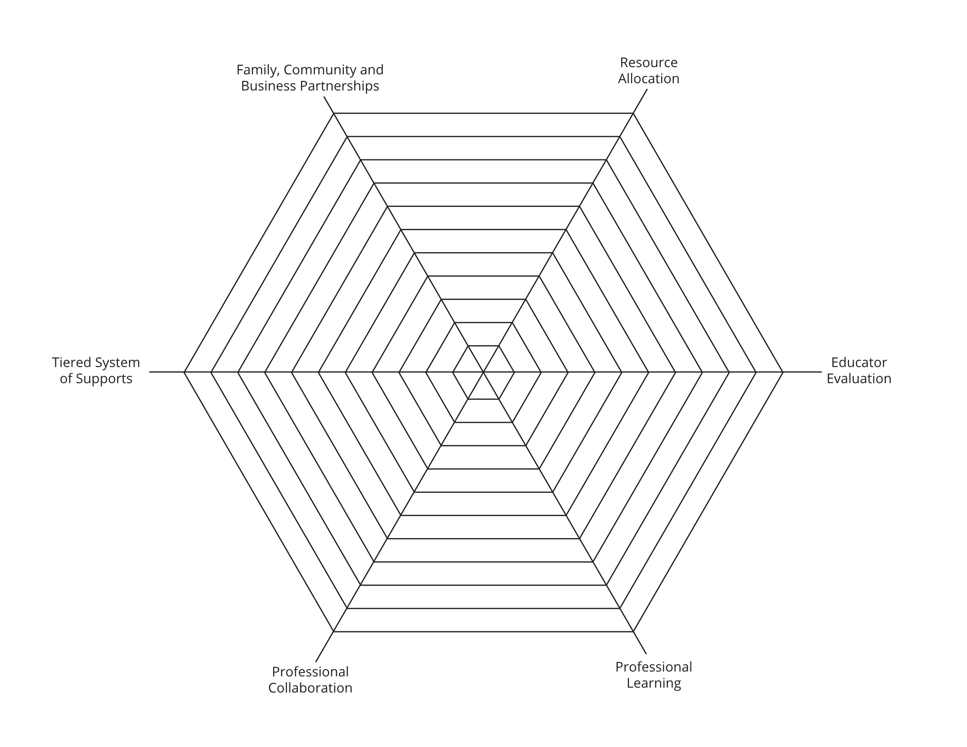
Current State Activity
The purpose of this activity is to have each DLT analyze the current state related to each structure and lead indicator. The system will mark 1-10 (1 = low, 10 = high) as to where they perceive current implementation of each structure/lead indicator. Through DLT conversation, one person will record on the graph the number associated with each structure/lead indicator and once completed, the recorder will color in the graph, creating a shape for the “current state.”

Slide 39
Table Top Discussion
Data Review & School Improvement
Key takeaways?
Questions you have?

Slide 40
Action Plan
School Improvement Day

Slide 41
Action Plan Objectives
During this portion of the School Improvement Day, the Facilitator and systems will …
Review the action plan template.
Review action plan examples.
Discuss likely action plan priorities.

Slide 42
Steps: Action Plan
90 minutes
See Facilitator Guide for more details on each of these steps.
Action Plan Template
10 Minutes
Review the action plan template.
Slide and hard copies available.
Action Plan Examples
20 minutes
Walk-through example action plans.
Slide and hard copies available.
Action Planning
60 minutes
Facilitate Action Planning
Slides available.

Slide 43
Action Plan
Component of an Action Plan
1 Fundamental Emphasized
1 or 2 Structures/Lead Indicators (with Local Context for each Structure)
1 or 2 Measures of Progress per Structure/Lead Indicator
Answer the 3 Questions (Why, Current Data/Evidence, What’s Next)
School system can have 1 or 2 total components in the Action Plan in 24-25

Slide 44
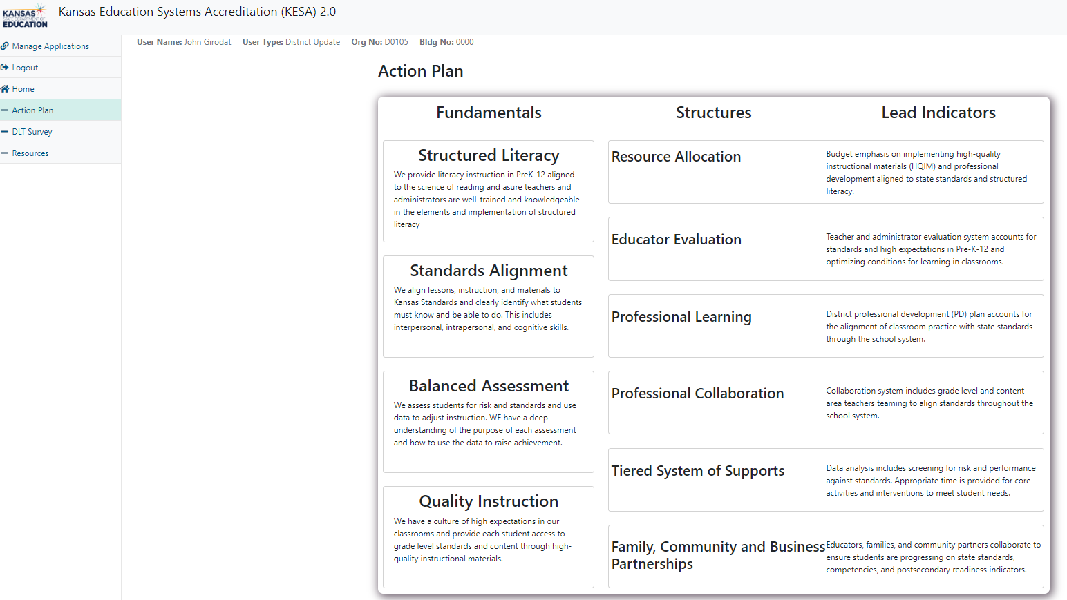

Slide 45
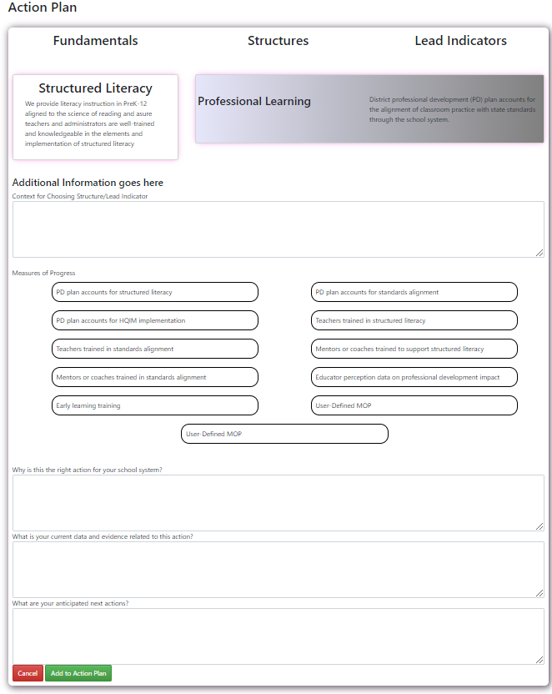
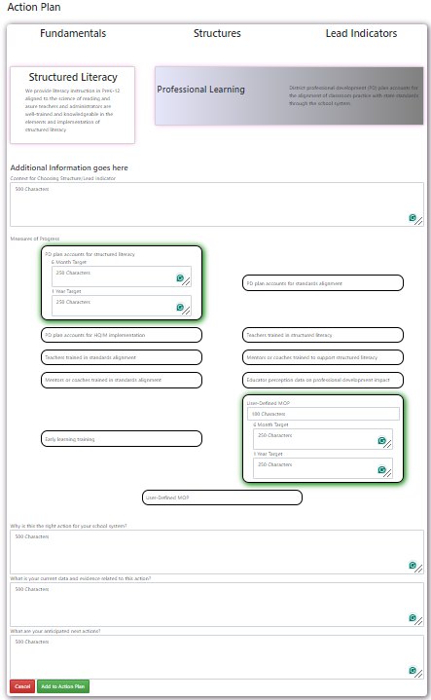

Slide 46

Action Plan Review Process
System attends School Improvement Day
System submits Action Plan in KESA Application (new)
KSDE Action Plan Review team reviews System’s Action Plan and provides feedback
System’s Action Plan ratings:
Ready to Implement
Needs Improvement
Incomplete
Ready to Implement – begin implementing
Needs Improvement or Incomplete – System must revise and re-submit
60 Days
2 weeks
Action Plans will be reviewed for:
1. Clarity
2. Alignment
3. Data-driven

Slide 47
Table Top Discussion
Action Plan
Key takeaways?
Questions you have?

Slide 48
School Community Engagement
School Improvement Day

Slide 49
School Community Engagement Objectives
During this portion of the School Improvement Day, the Facilitator and systems will …
Discuss current collaborative structures within the school system, including collaboration with all staff, the local board of education, and site councils.
Develop a plan to engage all staff, the local board of education, and site councils over the next two months before finalizing the KESA action plan.

Slide 50

Steps: School Community Engagement
30 minutes
Current Collaboration Structures
App. 15 minutes
Facilitate DLT and whole group conversation on how the school systems communicate and collaborate with all staff, the board of education, and site councils.
Collaboration Plan
App. 15 minutes
Develop a plan to share the discussions from the school improvement day and potential action plan items with all staff, the board of education, and site councils to get feedback before finalization of the plan.
Special Note: For this topic, school systems should have thought about this item prior to the school improvement day.
School Improvement Day – School Community Engagement

Slide 51
Review
School Improvement Day

Slide 52
Review Objectives: School Improvement Day
During this portion of the School Improvement Day, the Facilitator and systems will …
Ensure that each system knows their next steps.
Discuss the timeline for school community collaboration.
Discuss the timeline for the action plan submission.

Slide 53

Review:
School Improvement Day
15 minutes
Discuss next steps for each DLT. (Slide)
  Ask each DLT to report their plan for the next 60 days.
  Make sure they address how they will engage the school community.
  Make sure they share their plan to get the DLT together to submit their final action plan within approximately 60 days of the school improvement day.

Slide 54
Wrap-up for Today

Slide 55
KESA 2.0 – Main messages
Instructionally-focused
Improved environment for teachers.
Flawed
Sustainable improvement

Slide 56
Review of this session
Feedback on today’s session
Questions and concerns
Words of wisdom

Slide 57
For more information, contact:
Ben Proctor
Deputy Commissioner
Division of Learning Services
W: (785) 296-2303
C: (316) 587-5665
bproctor@ksde.org
Jay Scott
Director
Accreditation and Design
W: (785) 296-6818
C: (785) 230-4575
jscott@ksde.org

